Slide 1


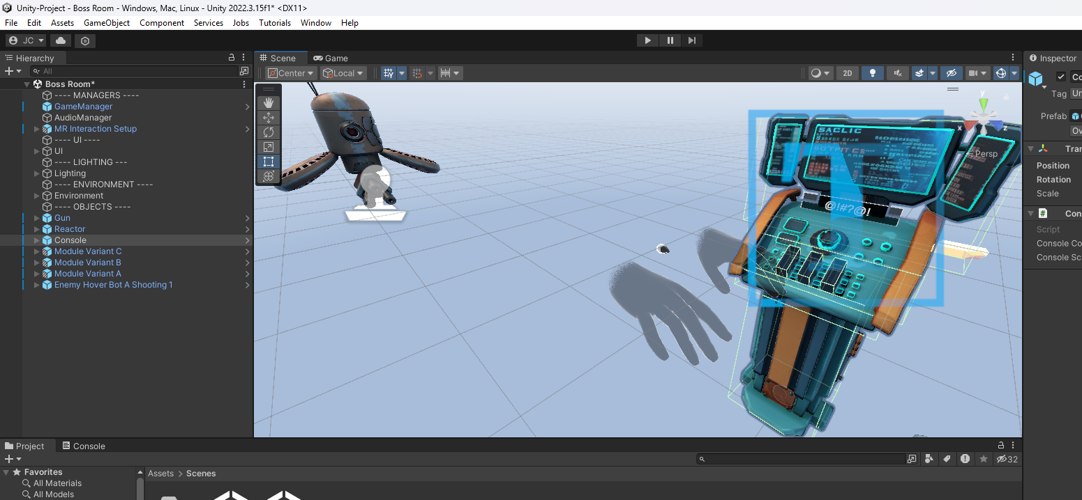
Virtual Reality
Wednesdays at 6:00pm
CIST 1423 - 2010 VIRTUAL REALITY PROGRAMMING AND TECHNOLOGY

Slide 2
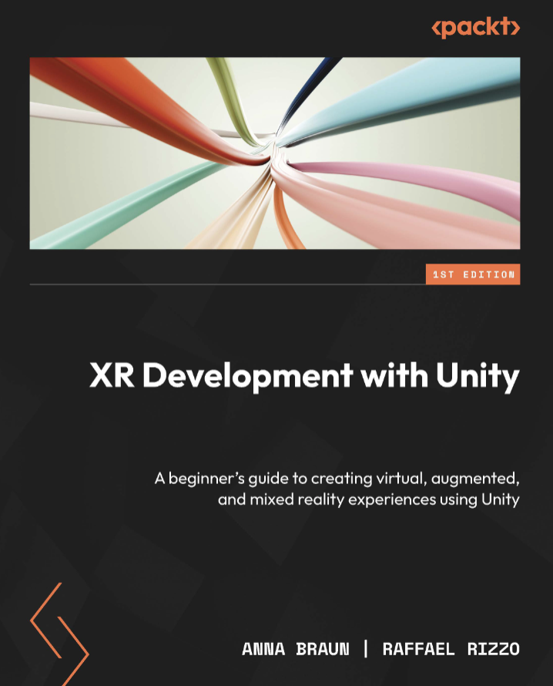
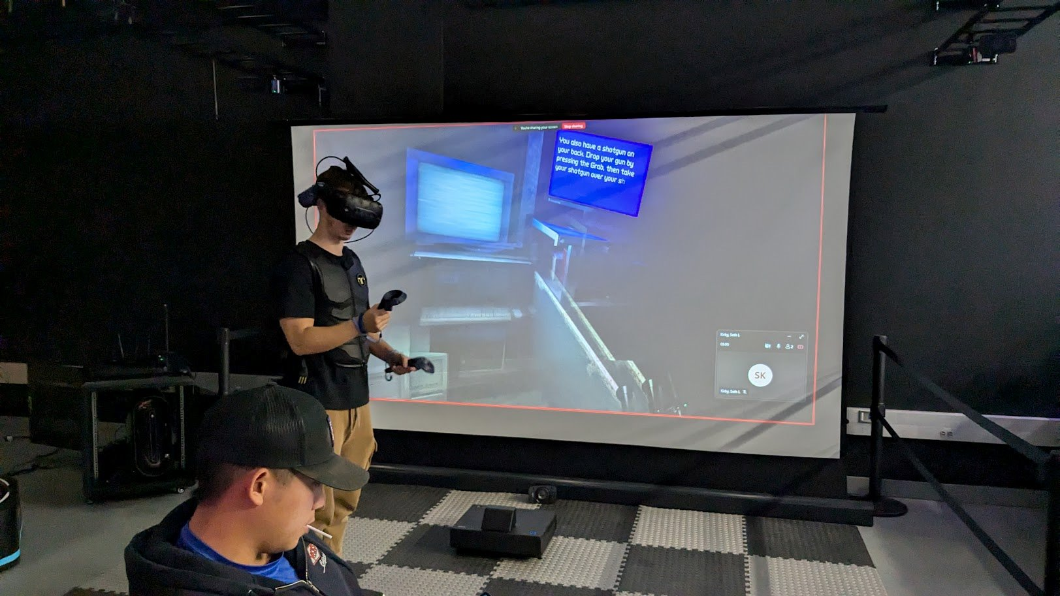
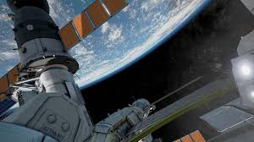
Agenda
Syllabus
Development Setup
Intro to Unity
Textbook
Weekly Plan & Final Project
Events
VR Lab

Slide 3
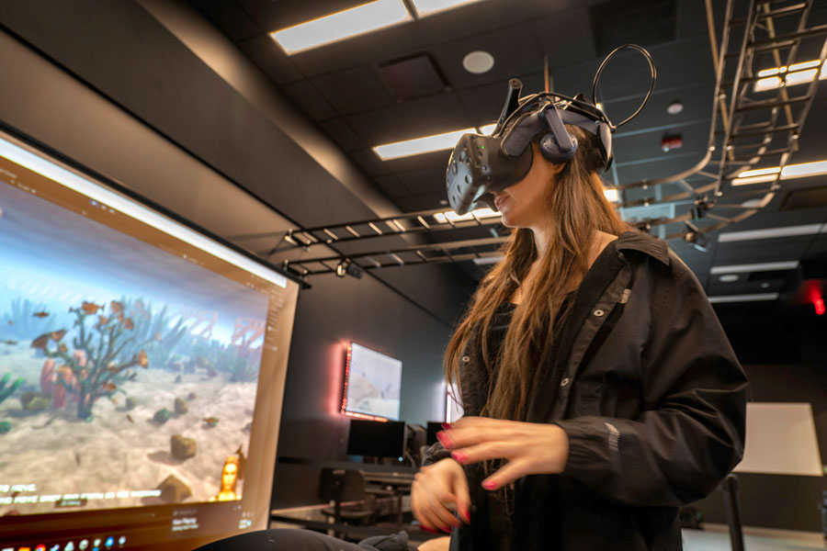
VR Lab
Stage w/ HTC Vive Pro 2
HTC Focus
Meta Quest 2 and 3
Microsoft Hololens
PS Coming Soon
Break-out areas

Slide 4
Syllabus
https://canvas.pitt.edu/courses/381238/assignments/syllabus ​
    Weekly Plan
    Homework
    Exams
    Final Project

Slide 5

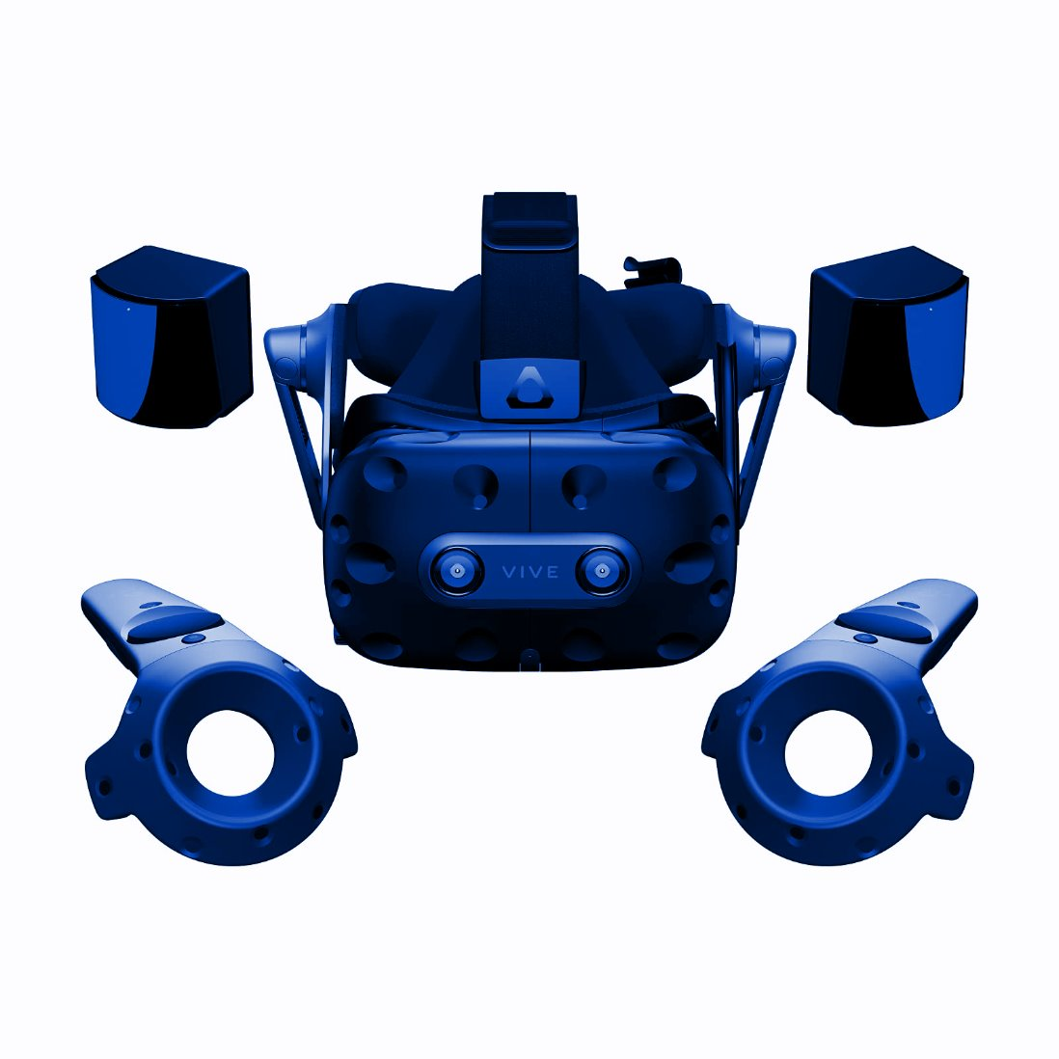
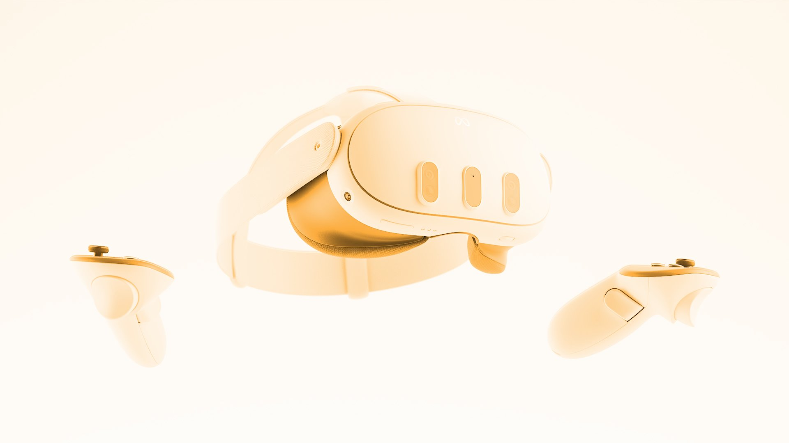
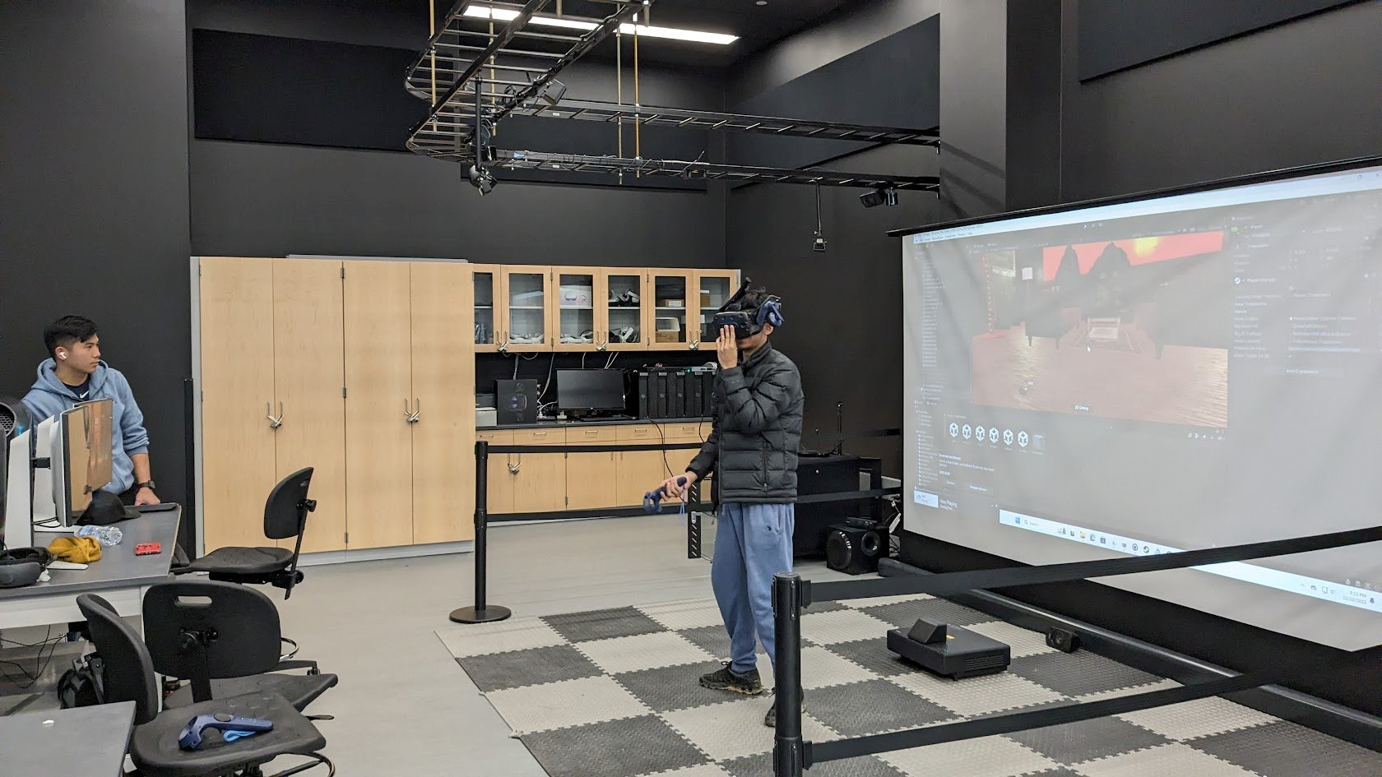
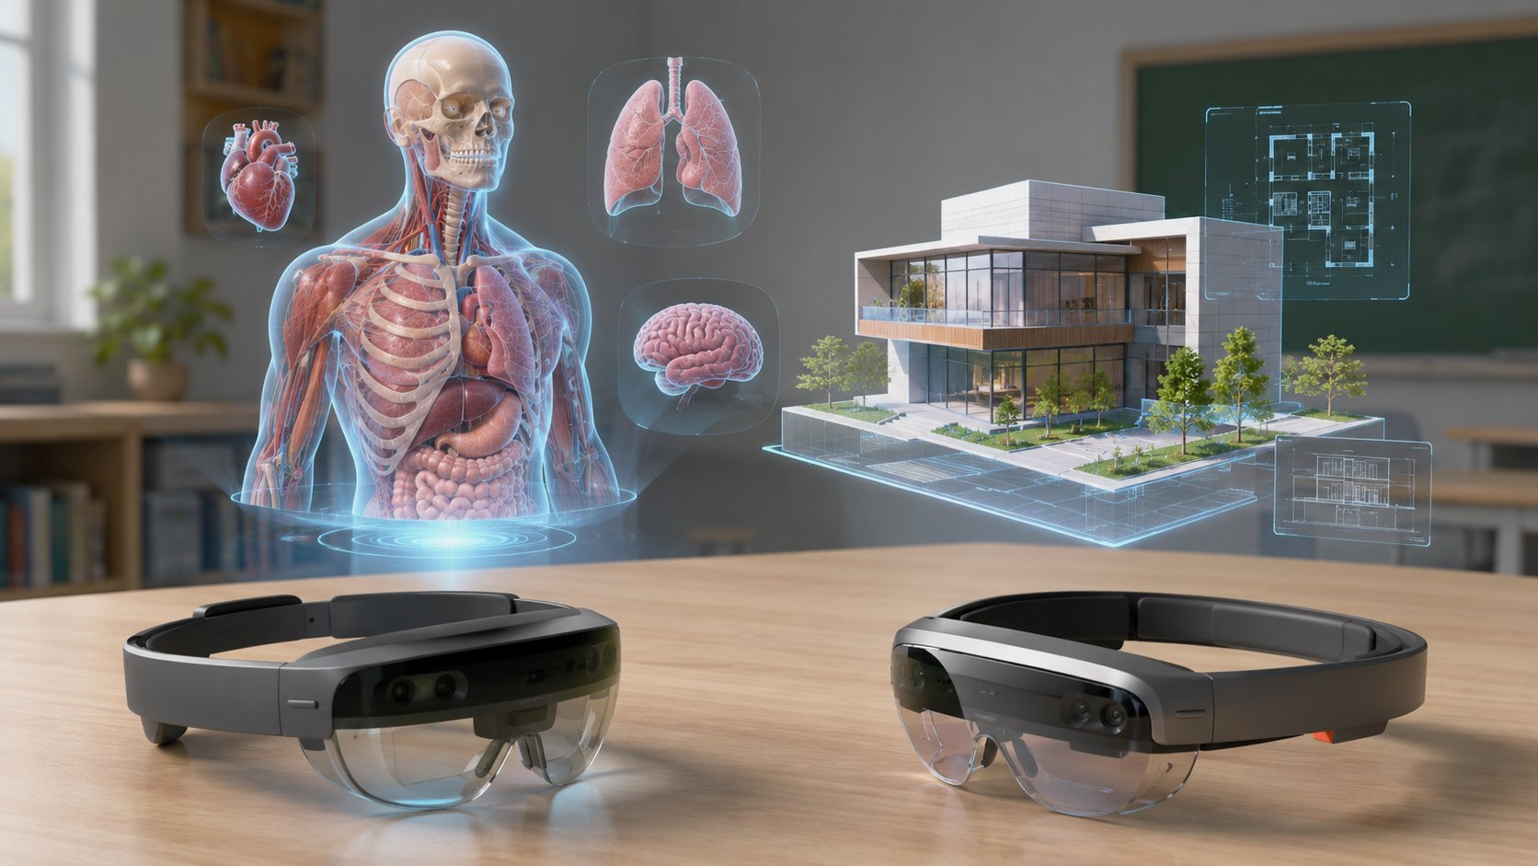
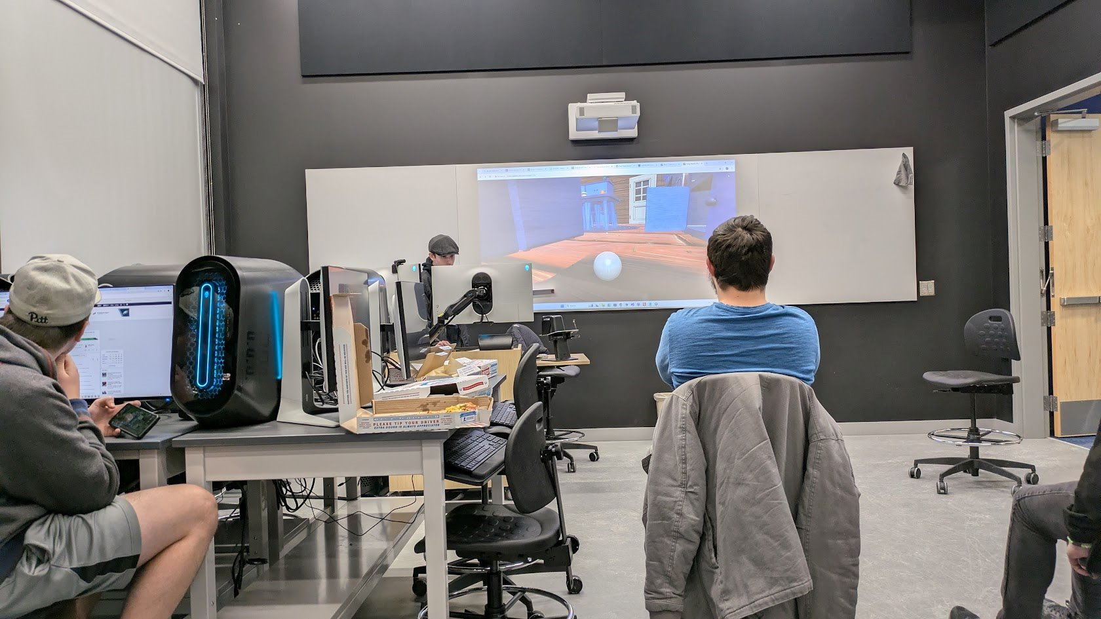
Next, let's test out some hardware
Quest 3s & 3
Quest 2 (as backups)
Stage with HTC Vive Pro 2 (PS have these available also for student use)
HoloLens
HTC Vive XR

Slide 6
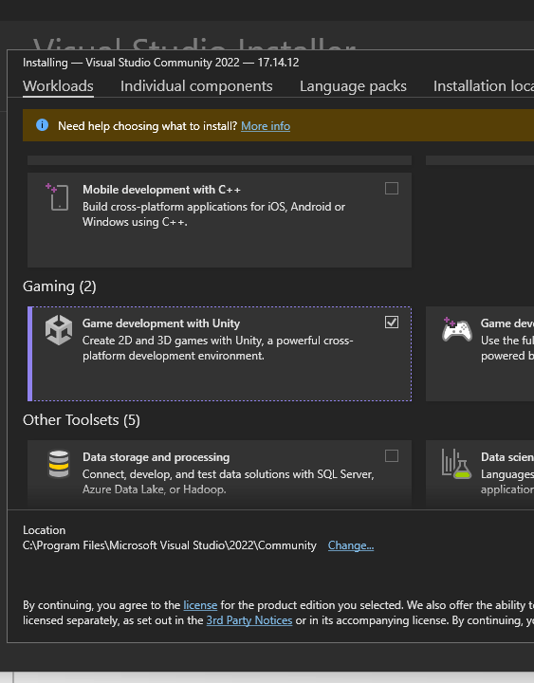

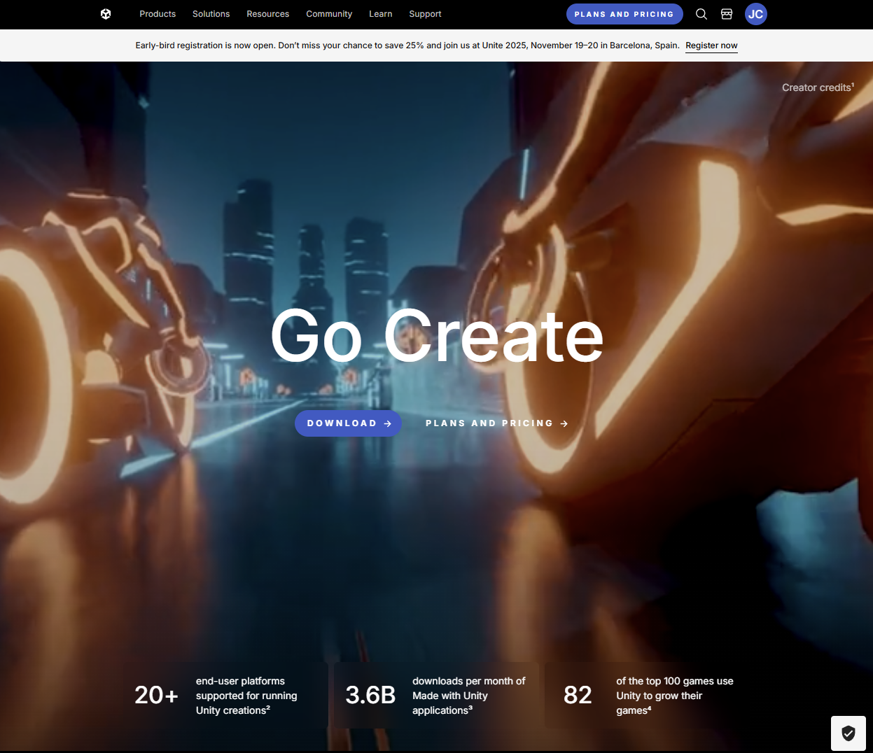

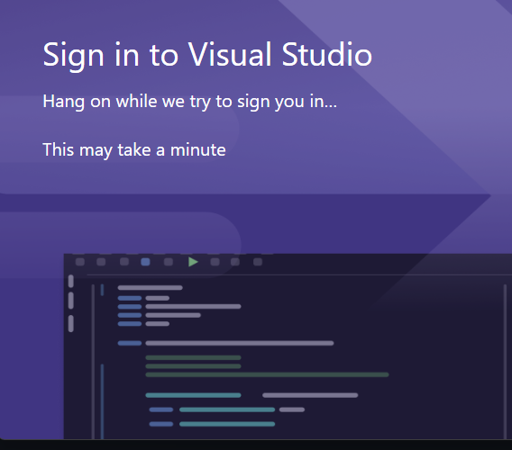
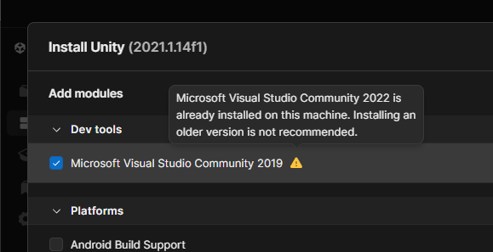
Development Setup
GitHub Account
  Github.com
  https://desktop.github.com/download/
Unity Account
  https://unity.com/
  https://assetstore.unity.com/
Visual Studio
  Visual Studio Setup
  Visual Studio 2022, Game Development with Unity
  Select 'Sign in with GitHub'
Unity 2021
  2021.3.58f1
  https://unity.com/releases/editor/archive
  Uncheck 'Microsoft Visual Studio Community 2019'
  Check 'Android Build Support' (and allow sub items to be checked)
  Check 'Windows Build Support (IL2CPP)' ('Universal' is for Xbox, HoloLens & Windows Store)

Slide 7
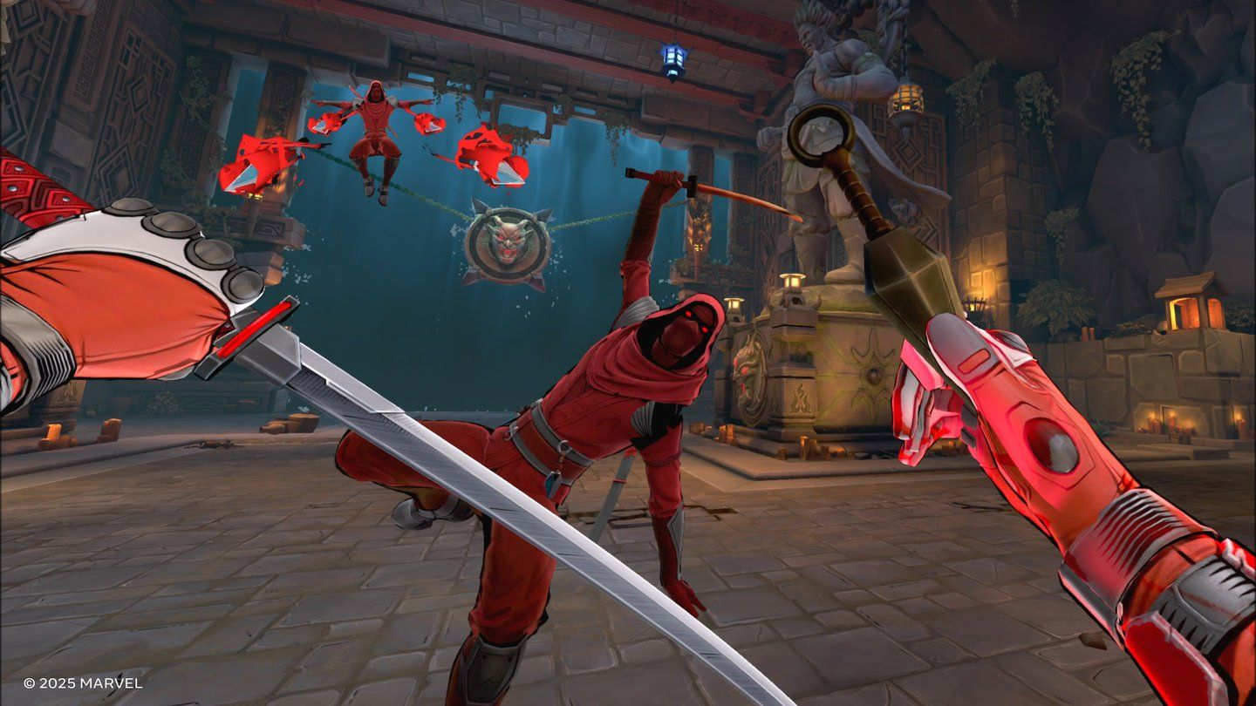
Setup Notes
C:\GitHub for all projects
  Make a new folder in the root of the C drive, before downloading any projects.
  NOT in Documents
  PS: We can also via P:\VR\Fall-2025
Add Exclusion for GitHub Folder
  Windows Defender, Virus and Threat Protection Settings
  Exclusions
  C:\GitHub
Markdown Editor - https://dillinger.io/

Slide 8
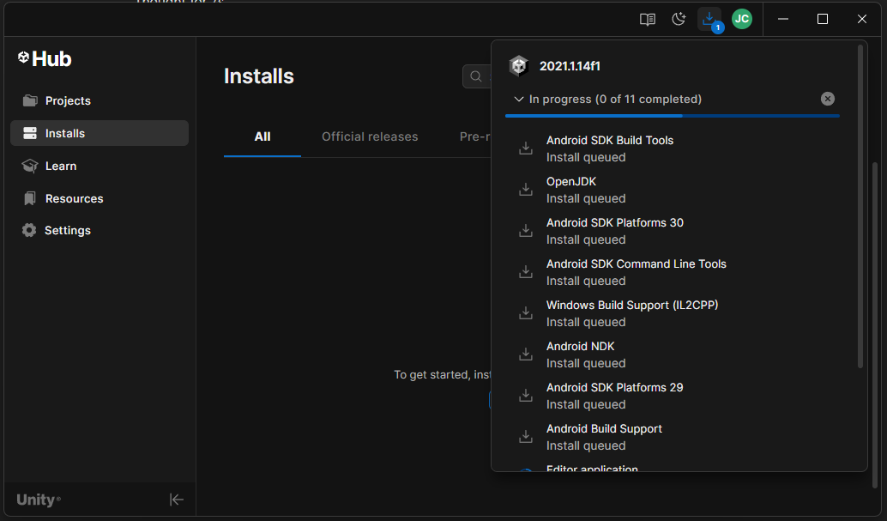
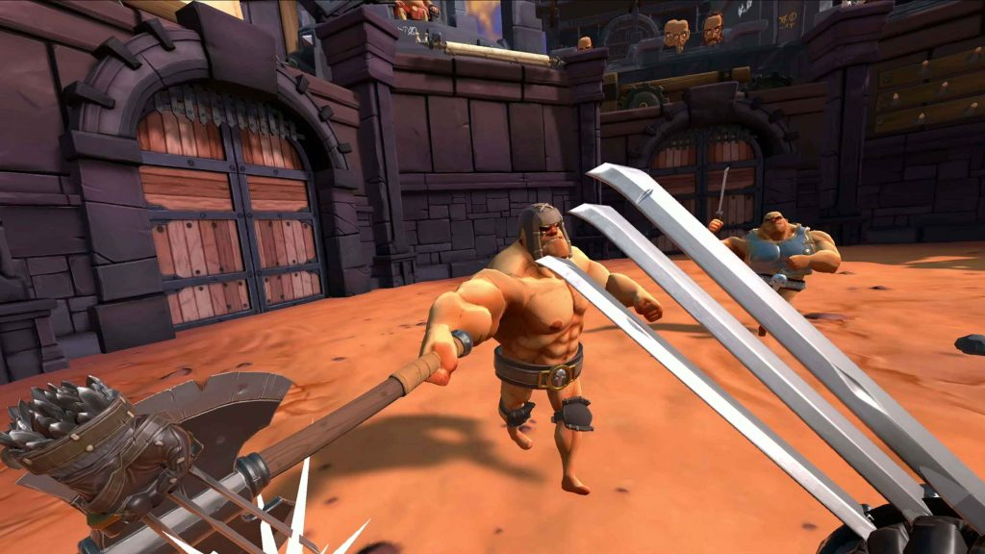
This may take a while

Slide 9
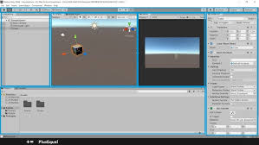
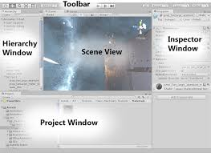
Intro to Unity
Toolbar
Hierarchy Window
Scene View (And Game View)
Inspector Panel
Project Window
Example project to check out:
https://github.com/jcallinan/VRPsych2024

Slide 10
Steam VR SDK
https://store.steampowered.com/app/250820/SteamVR/
Steam VR & Steam VR Test Scene - an extensive example including picking up, throwing objects, and animated hands - Interaction System example at /SteamVR/Interaction System/Samples/Interactions_Example​
https://store.steampowered.com/app/250820/SteamVR/ ​

Slide 11
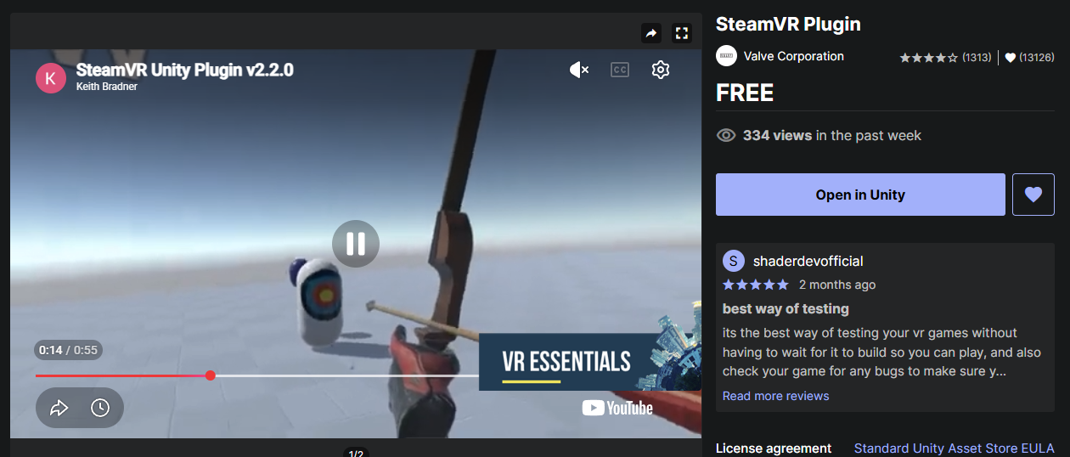
Unity & SteamVR : SteamVR
Add the SteamVR Plugin to your assets and open in Unity:
Click on the link
Click on ‘Open in Unity’
If that’s not there, click on ‘Add to My Assets’
https://assetstore.unity.com/packages/tools/integration/steamvr-plugin-32647?gclid=Cj0KCQjwy9-kBhCHARIsAHpBjHjIePEVu9R_zLplHHlVamVGslT8foRndRg4GEenoPYohDI8QuCqExAaAi3gEALw_wcB&gclsrc=aw.ds

Slide 12
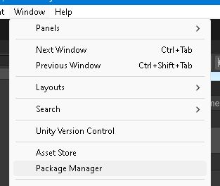
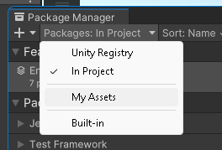
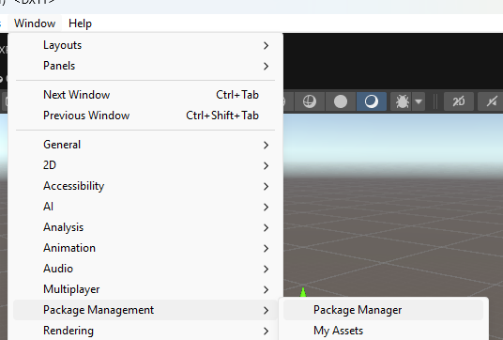
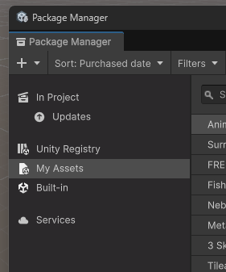
Unity & SteamVR : SteamVR
Find the SteamVR Plugin to import to your project :
In Unity, go to ‘Window, Package Manager’, or 'Window, Package Management, Package Manager' depending upon version
Then in Package Manager, pick ‘My Assets’ either from drop down or left nav.

Slide 13
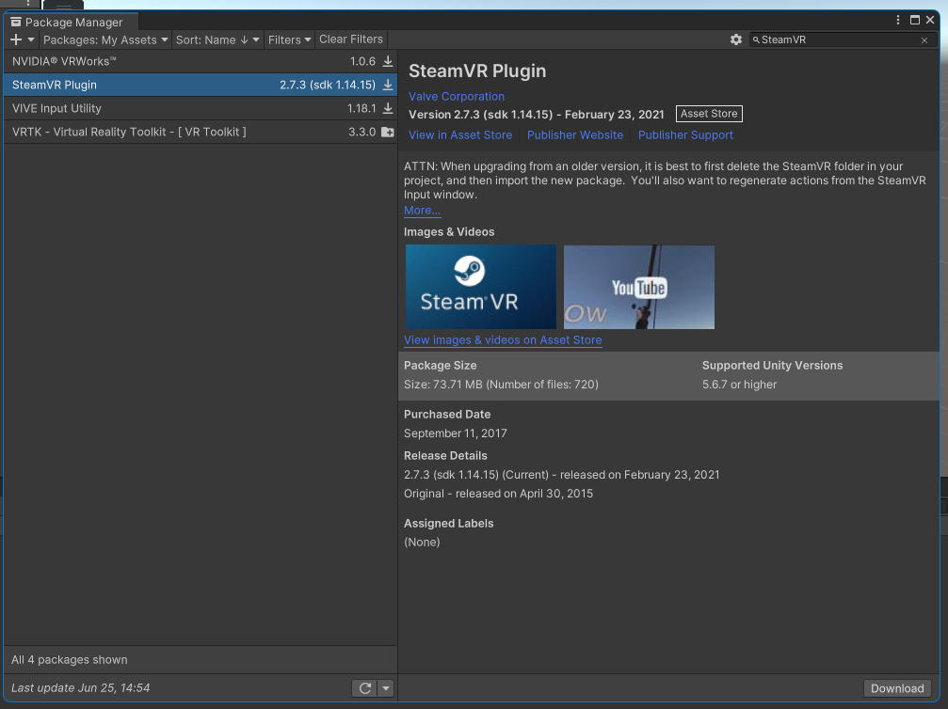
Unity & SteamVR : SteamVR
Import the SteamVR Plugin in to your project:
Then, search for ‘SteamVR’
Click on ‘Download’ on the bottom right
Then, click on ‘Import’

Slide 14
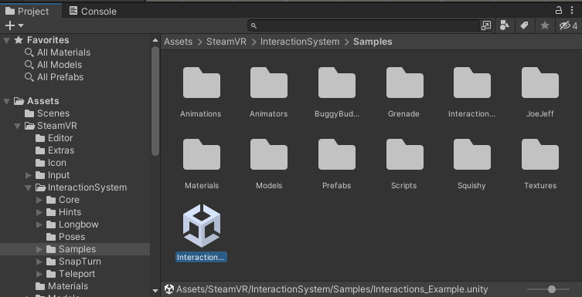
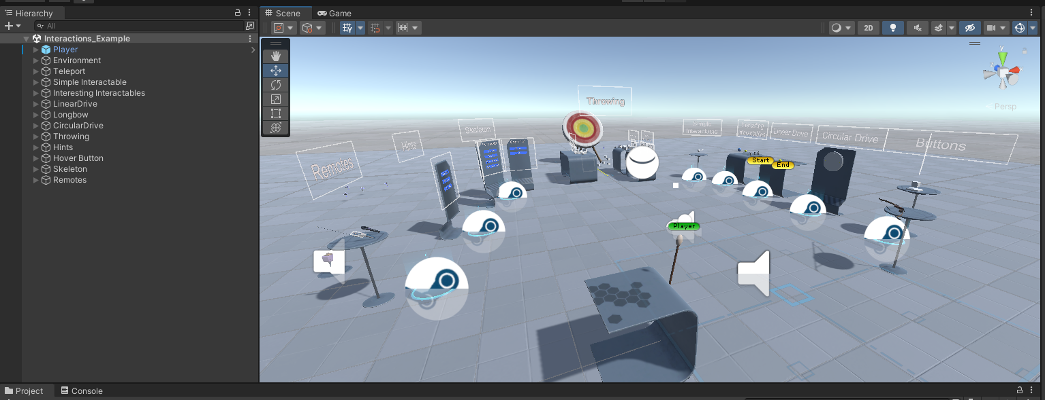
Unity & SteamVR : SteamVR
Next, After import is complete, find this scene:
Assets\SteamVR\InteractionSystem\Samples\Interactions_Example.unity

Slide 15
SteamVR: The Scene
Now, let’s explore this scene in Unity's editor:
Left click to select
Left alt-left click to rotate scene
Right click to angle camera
Scroll wheel to zoom in and out
Press down scroll wheel to shift camera left and right

Slide 16
XR Development with Unity
A beginner's guide to creating virtual, augmented, and mixed reality experiences using Unity
Pitt Library textbook link
O'Reilly online version - easy to navigate
GitHub repo link - https://github.com/PacktPublishing/XR-Development-with-Unity
Also demo videos of the projects created in this book are available in the GitHub repository: https://github.com/PacktPublishing/XR-Development-with-Unity/tree/main/Additional%20Resources
Also, copy of textbook here in Canvas - https://canvas.pitt.edu/courses/381238/files/folder/Uploaded%20Media

Slide 17
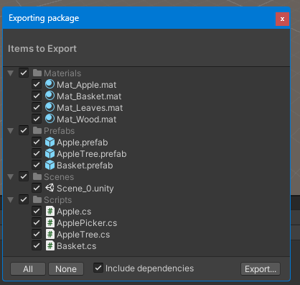
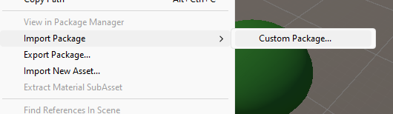
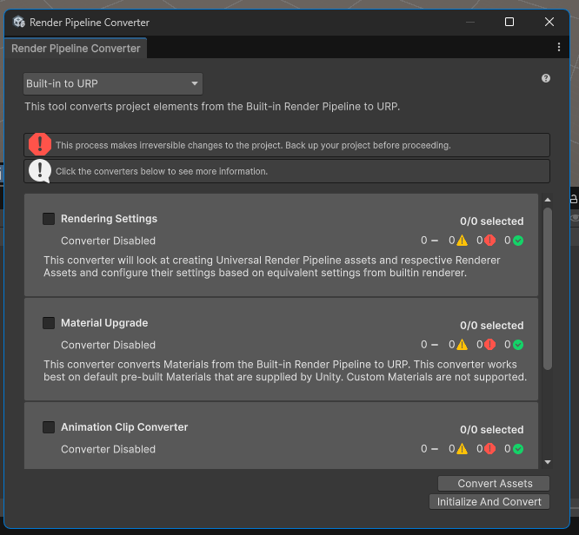
PS: Working with different versions of Unity
Packages – for importing and exporting
Universal Render Pipeline Convertor
Unity 2019: The LTS version (2019.4) is noted for its stability for shipped products.
Unity 2020: Introduced the Mixed and Augmented Reality Studio (MARS) and added support for Apple Silicon.
Unity 2021: Brought significant new features, including the visual scripting system Bolt, a new multiplayer library, and general performance improvements.
Unity 2022: Focused on enhancing productivity with faster loading times for projects, improved 2D tools, and a visual search system.
Unity 2023: Continued to add and refine features.
Unity 6 (2024): A major update that reverted to a numbered system and included new generative AI tools (Unity Muse and Unity Sentis), improved multiplayer tools, and enhanced graphics rendering.

Slide 18
Events
Alumni and Family Weekend campaign launch party on Friday, September 25, starting at 5:30PM
"one of the activities we’d really like to feature during this party is the Virtual Reality lab to our donors and give them the opportunity to experience it themselves. This will be 5:30 until 7:00PM – afterwards, we would open it up to the public a bit longer to also participate."
Sept. 26, 11 a.m.–1 p.m. -- Virtual Reality Lab Experience, with hands-on demonstrations of the university's VR technology. George B. Duke Engineering and Information Technologies Building, University of Pittsburgh at Bradford
Halloween Party
PS Global Game Jam in January - https://globalgamejam.org/

Slide 19
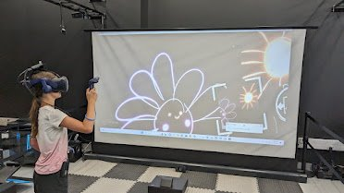
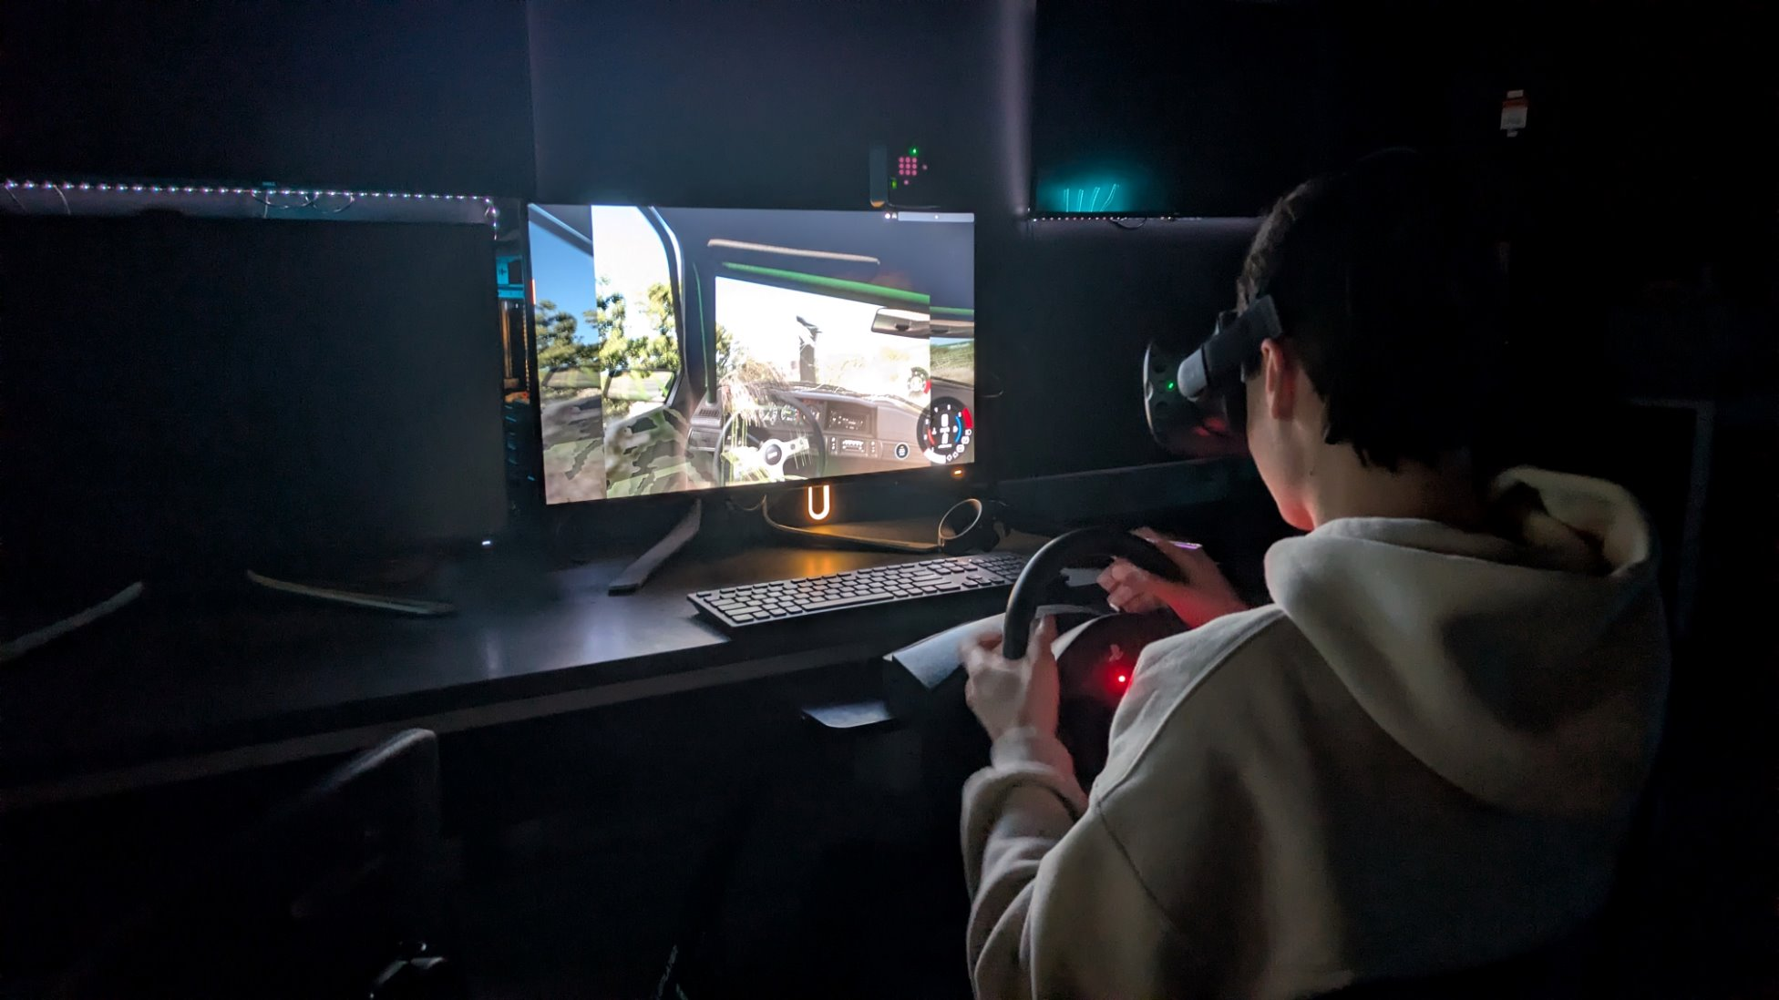
Logistics
Friday, Sept. 25 — Launch Party
•5:30–7:00 PM: VR Lab open exclusively to donors and alumni
•7:00 PM onward: Open to the general public
Saturday, Sept. 26 — VR Lab Experience
•11:00 AM–1:00 PM, hands-on demos for all attendees
•George B. Duke Engineering and Information Technologies Building, Pitt Bradford
Setup Checklist (arrive 1 hour early)
•Charge and test all headsets: Vive Pro 2, Meta Quest 2/3, HoloLens, do we want to set up racing with Vive Pro 2?
•Load demo builds and apps; keep Meta XR Simulator as a backup
•Sanitize wipes staged at every station
•Power strips and extension cords run and taped down

Slide 20
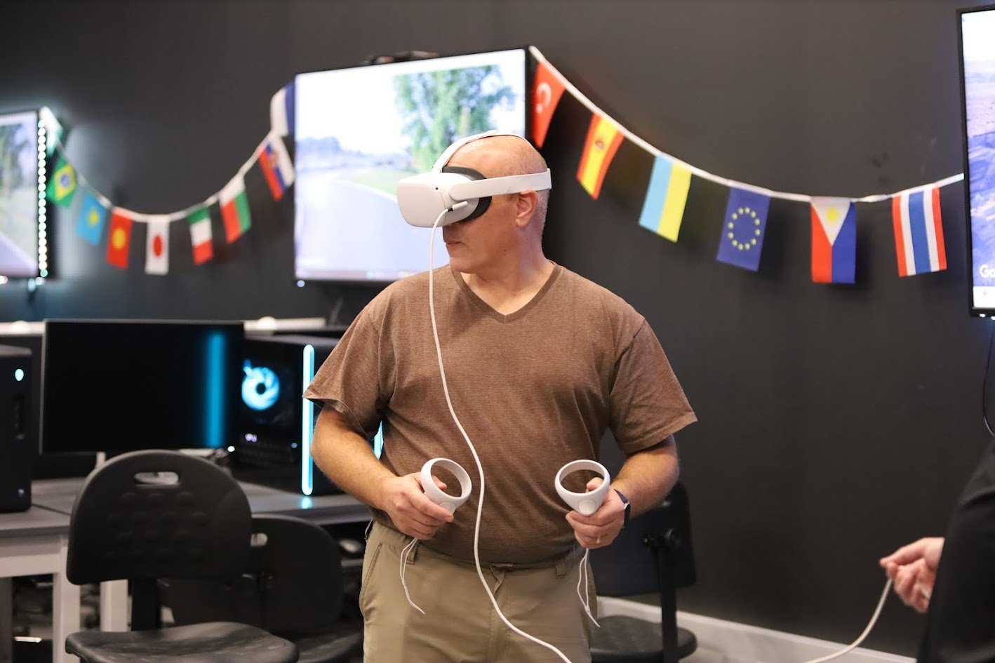
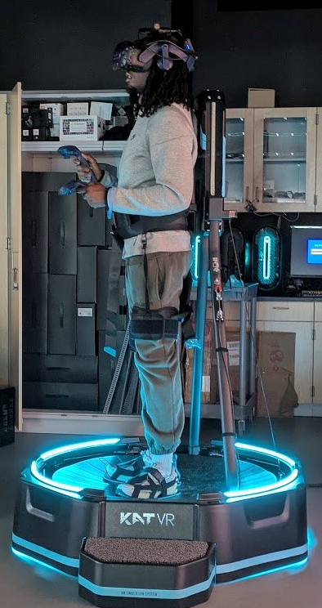
Roles
Volunteer Roles
•Greeter — welcomes visitors, explains what's available
•Headset Wrangler — sanitizes and resets headsets between users, manages the queue
•Demo Runner — launches the chosen experience, guides controls
•Floater — troubleshoots issues, restocks stations as needed
Shifts
•Friday: 5:00–7:30 PM (launch party)
•Saturday: 10:45 AM–1:15 PM (public lab experience)

Slide 21
Next steps
Sundays?
Thursdays?
Schedule Prep Nights

Slide 22
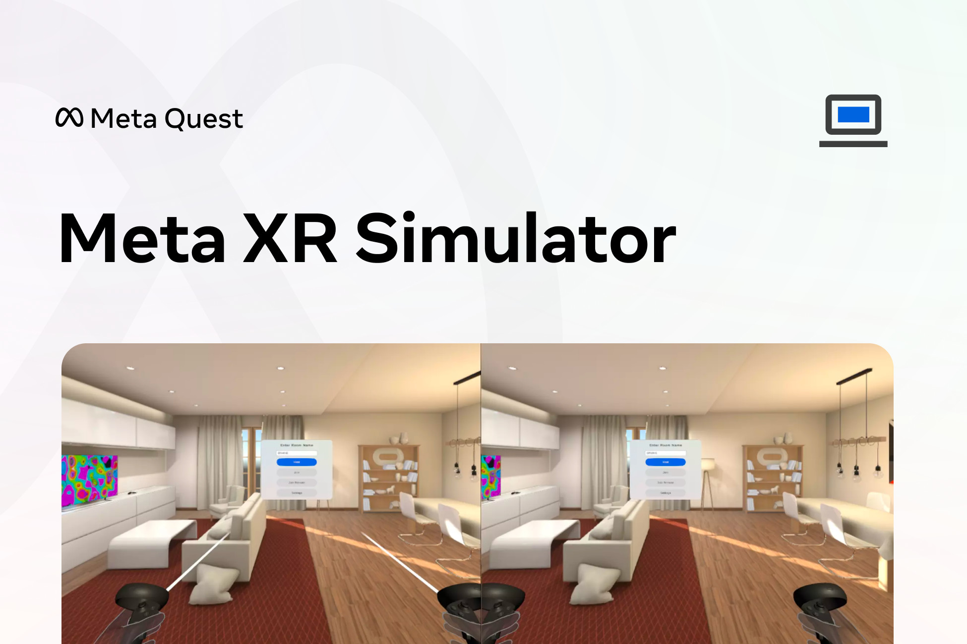
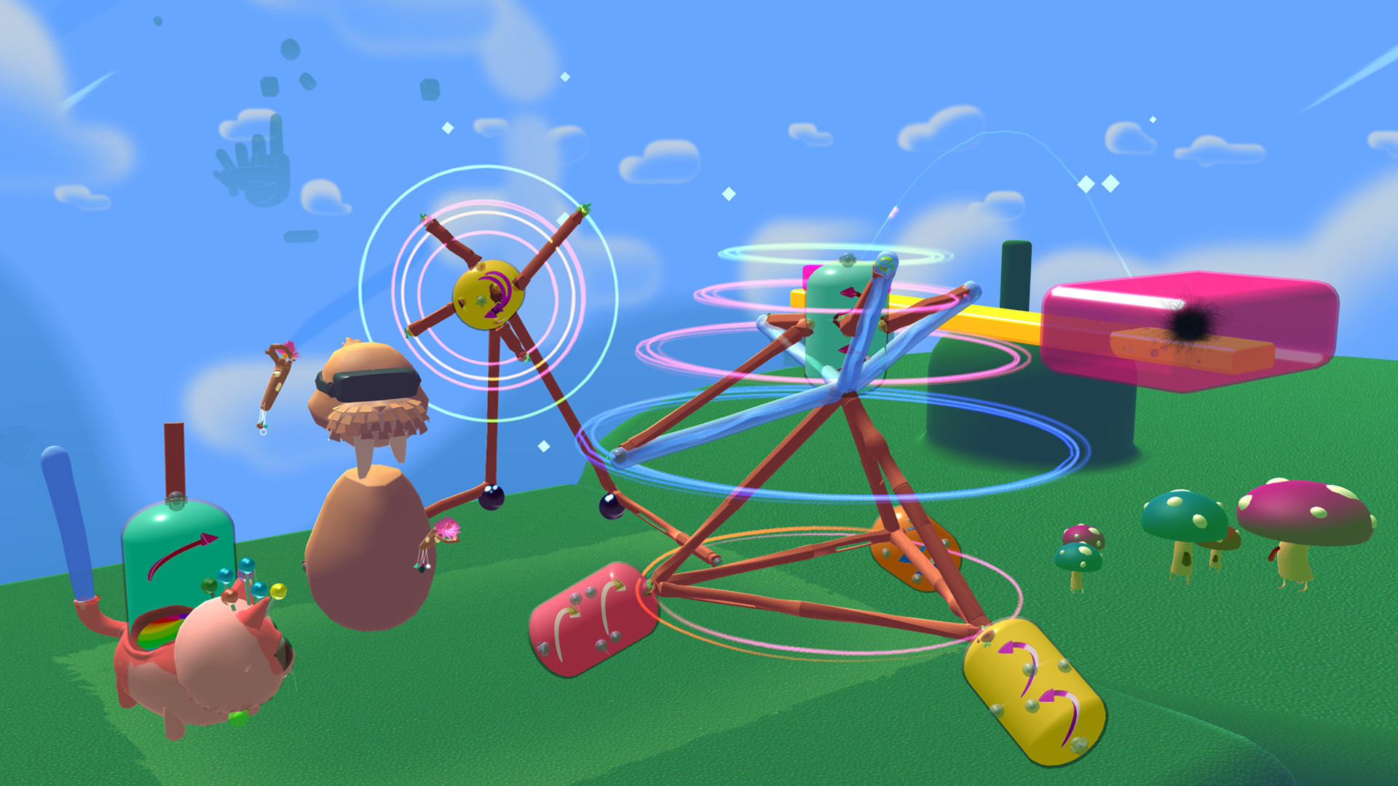
Meta XR Simulator
https://assetstore.unity.com/packages/tools/integration/meta-xr-simulator-266732
Meta XR Simulator is a lightweight XR runtime built for developers that enables the simulation of Meta Quest headsets and features on the API level.
It makes day-to-day development easier by enabling testing and debugging of apps without the need to put on and take off a headset frequently, and helps scale automation by simplifying your testing environment setup.

Slide 23
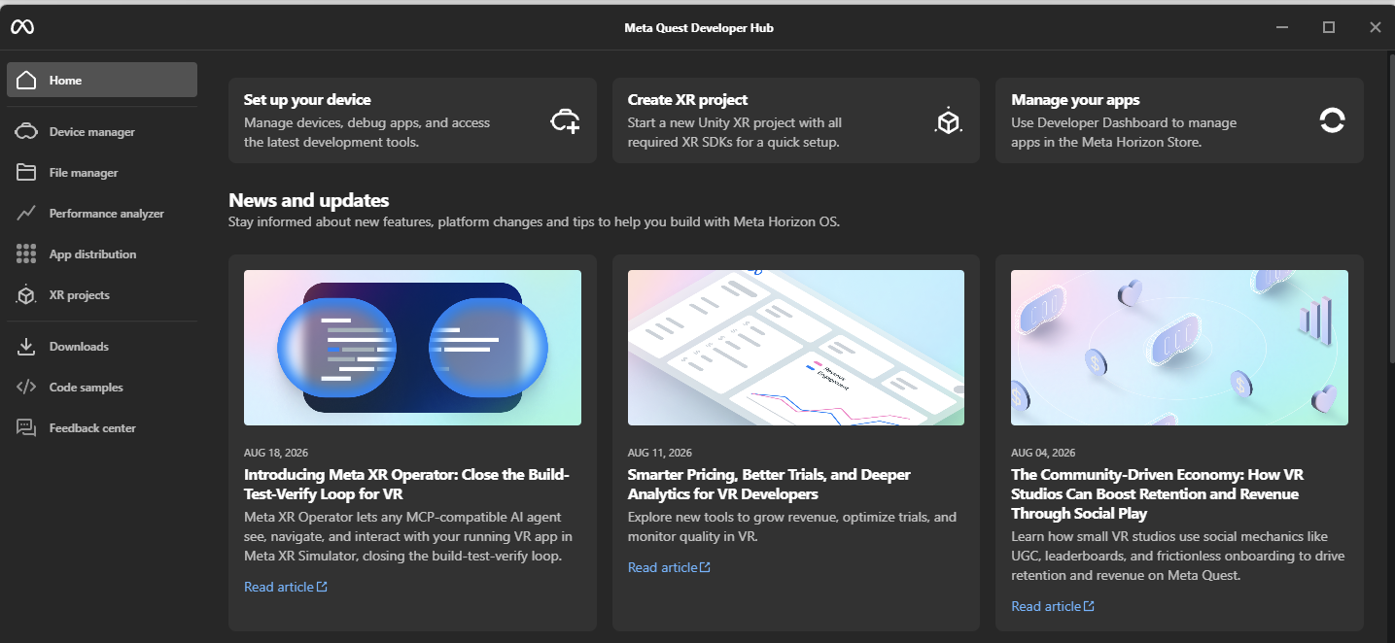
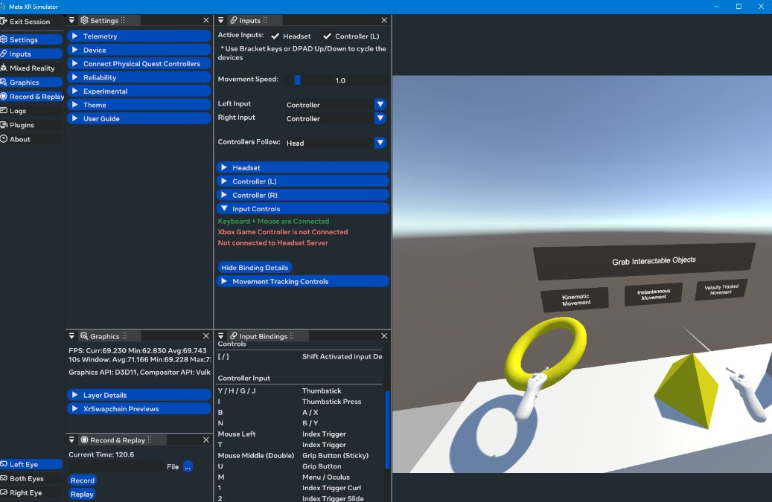
Meta Quest Developer Hub
Meta Quest Developer Hub (MQDH) is an application for Windows and MacOS that allows developers to manage their devices, debug their apps, and submit their apps to the Store.
https://developers.meta.com/horizon/documentation/unity/ts-mqdh/

Slide 24

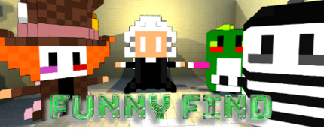
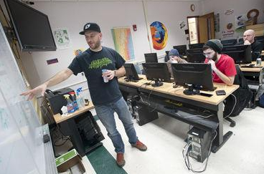



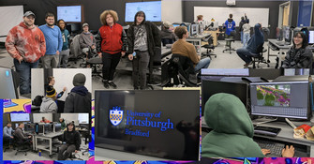
PS – in January - Global Game Jam
The Global Game Jam® (GGJ) is the world's largest game creation event
https://globalgamejam.org/jam-sites/2026/university-pittsburgh-bradford
https://globalgamejam.org/jam-sites/2025/university-pittsburgh-bradford
https://globalgamejam.org/jam-sites/2024/university-pittsburgh-bradford
https://globalgamejam.org/2023/jam-sites/university-pittsburgh-bradford
https://globalgamejam.org/2022/games/last-knight-5-0
https://globalgamejam.org/2021/jam-sites/university-pittsburgh-bradford
https://globalgamejam.org/2019/games/house-spouse-2-electric-bungalow
https://www.bradfordera.com/news/alternate-universe-pitt-bradford-students-create-video-game-in-weekend/article_2513cf3e-ca17-11e5-8bd6-2fa90e4fc756.html

